Slide 1
IML Project - MetaClassifiers
Santripta Sharma

Slide 2
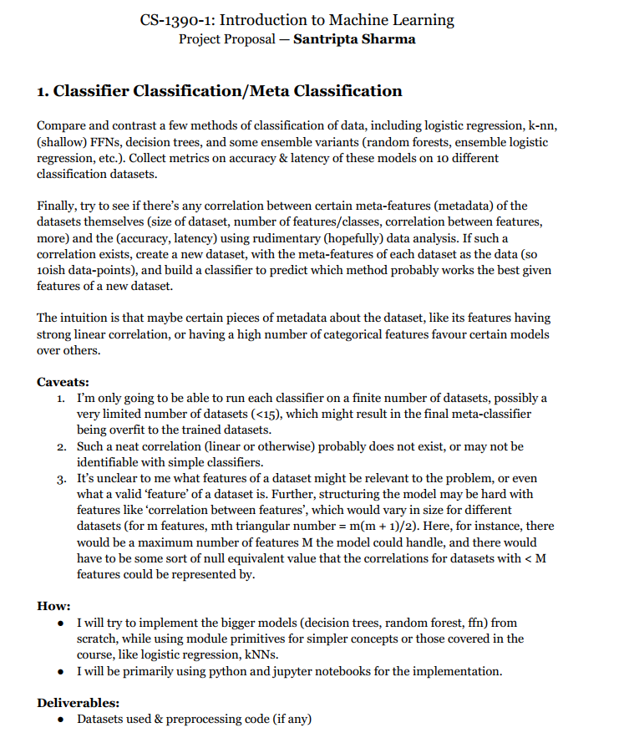
Proposal & Methodology
Collected & Manually Cleaned 13 Classification Datasets from Kaggle & HuggingFace
Preprocessed the Data, selected & encoded features, and generated metafeatures for each dataset.
Used scikit-learn’s models, and other primitives to train 5 model types on each dataset, got the best case accuracies for each model on each dataset.
Determined which model was overall most accurate for each dataset. This is the predictor for our metaclassifier.
Trained metaclassifiers (decision trees, logistic regressions, SVMs, and perceptrons) on the metadataset.

Slide 3
Results
With the 13 datasets, and the feature set given below:
(datapoint_count, feat_count, numeric_feats, avg_correlation, binary_feats, numeric:binary ratio w laplace smoothing, no. of classes/labels, rate of majority class)
I was unable to train a robust metaclassifier to predict which classifier type (of logistic, kNN, perceptron, decision tree, random forest) would achieve the best accuracy on it.
The conclusion I come to is that this set of simplistic features is unable to capture the relationship between the dataset and the optimal model for it. There are various “hard-to-quantify” meta features which are likely important for determining which model might perform well on a given dataset, such as task-type (image classification, tabular data classification, text classification, etc.) or domain (health, banking, etc.) that cannot be ascertained by statically analysing the dataset with a program.

